Slide 1
QUESTIONING THE RELIABILITY OF FORENSIC EVIDENCE: A LONELY BUT NECESSARY ROAD
AMANDA SELVARAJAH - MONASH AUS

Slide 2


Table of content
Lonely | Necessary
Legal Interpretation of Evidence Laws | Our Criminal Trials
 | The “Science”

Slide 3
forensic evidence as expert opinion evidence
s79(1) Evidence Act 1995 (Cth)
when a person has ‘specialised knowledge’
'based on the person’s training, study or expertise’
and opinion is ‘wholly or substantially based on that knowledge

Slide 4
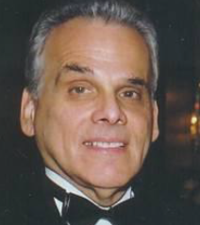
let’s test the test
Dr Ira Titunik
Practising dentist
Member of the American Board of Forensic Odontology
“no question in my mind”

Slide 5
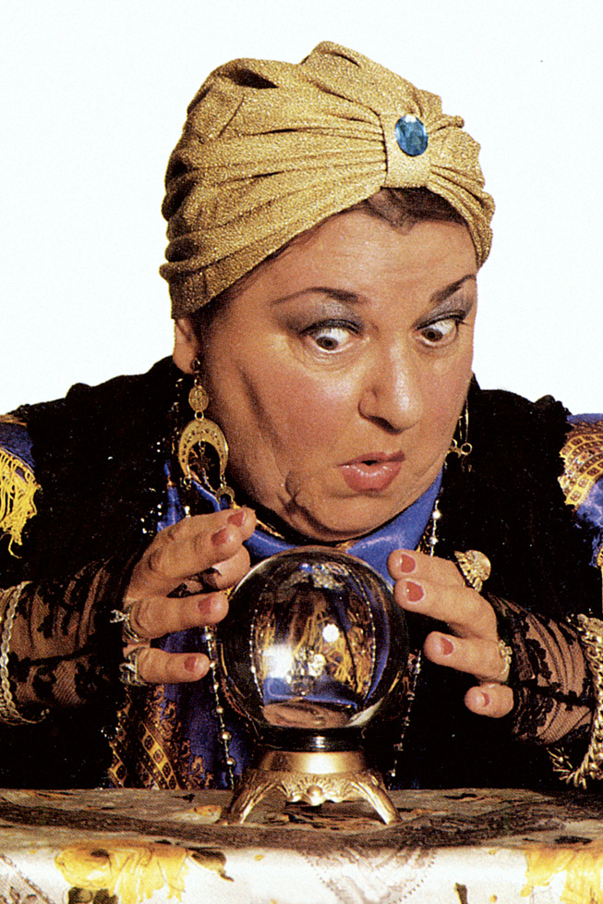
Let’s test the test
Specialised knowledge?
Based on training and expertise?
Opinion based on that knowledge?

Slide 6
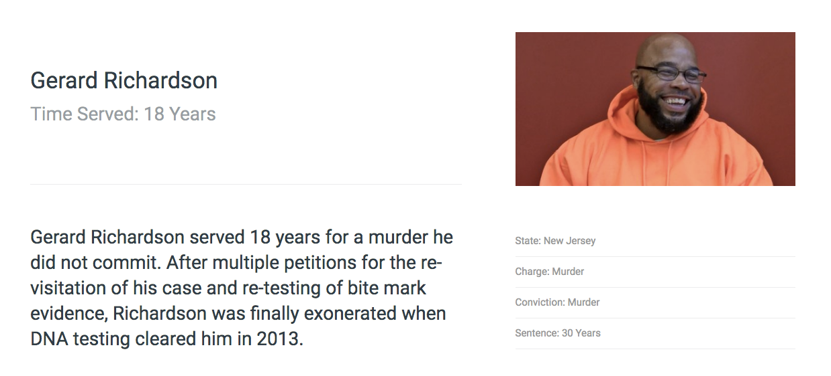
“The FBI looked at hairs, fibres, blood everything the police found at the crime scene. None of it came from me. Just this bite mark”
- Gerard Richardson

Slide 7
BITE MARK ANALYSIS
“President’s Council of Advisors on Science and Technology finds that bitemark analysis does not meet the scientific standards for foundational validity, and is far from meeting such standards” - 7 Sept 2016 Washington Post
Hundreds in prison today in America, at least 15 awaiting execution (Innocence Project, 2015)

Slide 8
An Expert’s reliability
Majority found evidence should be taken at its highest value and that reliability was not a factor of consideration - IMM v R (2016) [HCA]

Slide 9
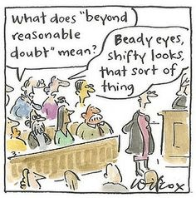
BURDENS OF JURY DUTY
  “All presumptive evidence of felony should be admitted cautiously; for the law holds it better that ten guilty persons escape, than that one innocent party suffer.”

Slide 10
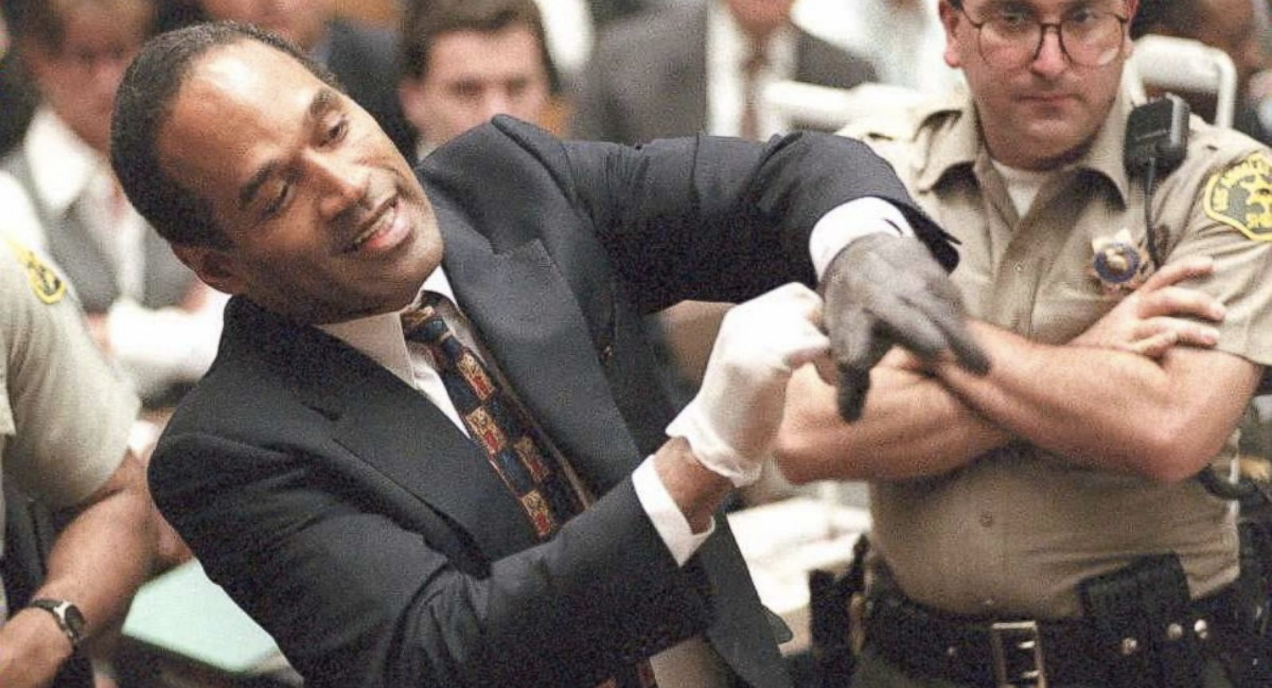
THE AVERAGE CRIMINAL TRIAL

Slide 11
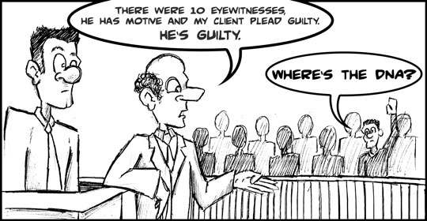
THE CSI EFFECT

Slide 12
THE “sCIENCE”
(with the exception of DNA) no forensic method has been rigorously shown to have the capacity to consistently, and with a high degree of certainty, demonstrate a connection between evidence and a specific individual or source
NAS Report 2009

Slide 13
questioning forensic evidence:
it won’t be easy
Time & Money
Sheer Impracticality
Bridging gaps of communication

Slide 14
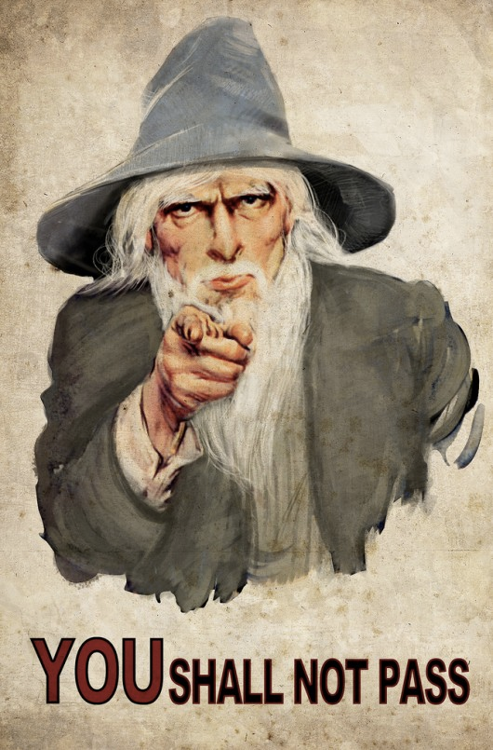
MY PROPOSITION
Judicial Gatekeeping
because the road is far too lonely
and that needs to change

