Slide 2
This is a court of law, young man, not a court of justice. ~Oliver Wendell Holmes, Jr.
In the Halls of Justice the only justice is in the halls. ~Lenny Bruce
When you go into court you are putting your fate into the hands of twelve people who weren't smart enough to get out of jury duty. ~Norm Crosby

Slide 3
Individualised Prosecution in International Criminal Justice
The Symbol vs. The Substance

Slide 4
International Crime
Genocide
War Crimes
Crimes against Humanity
Torture
Enforced Disappearances

Slide 5
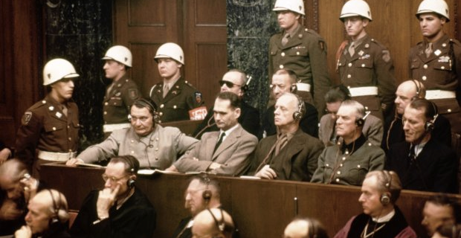
Mechanisms for International Criminal Justice
Nuremberg Trials
1945-46

Slide 6
Mechanisms for International Criminal Justice
International Court of Justice
International Criminal Court
International Criminal Tribunal for the former Yugoslavia
ICTR
Special Court for Sierra Leone
Extraordinary Chamber in the Courts of Cambodia
Special Tribunal for Lebanon
Special Panels of the Dili District Court
War Crimes Chamber of the Court of Bosnia and Herzegovina
War Crime Court at Kosovo

Slide 7
Objectives of International Criminal Justice
Justice for the Victims
Deterrence
Accountability

Slide 8
JUSTICE FOR THE VICTIMS
The Power of Truth

Slide 9
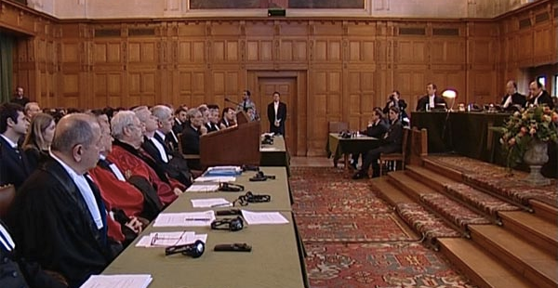
Justice for the Victims
The Prosecutorial Process

Slide 10
Prosecutorial Process
Limited role of the victim
Oversimplification of the narrative
Adversarial nature of the trial

Slide 11
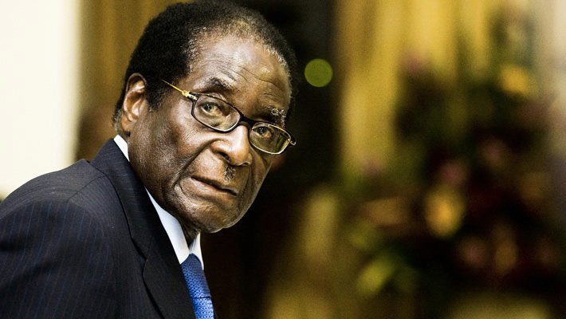
Justice for the Victims
Fear of Prosecution

Slide 12
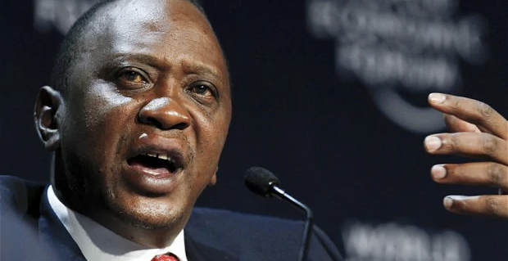
Deterrence
Faith in the Process

Slide 13
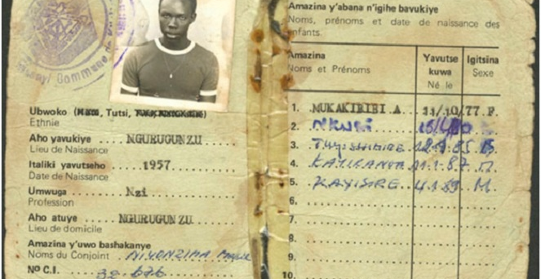
Deterrence
The Mitigating Factors of Criminality

Slide 14
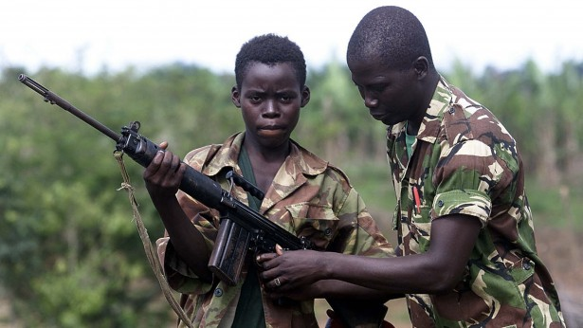
Accountability
The Mitigating Factors of Criminality

Slide 15
The Symbol

Slide 16
Final Thoughts

